Slide 1
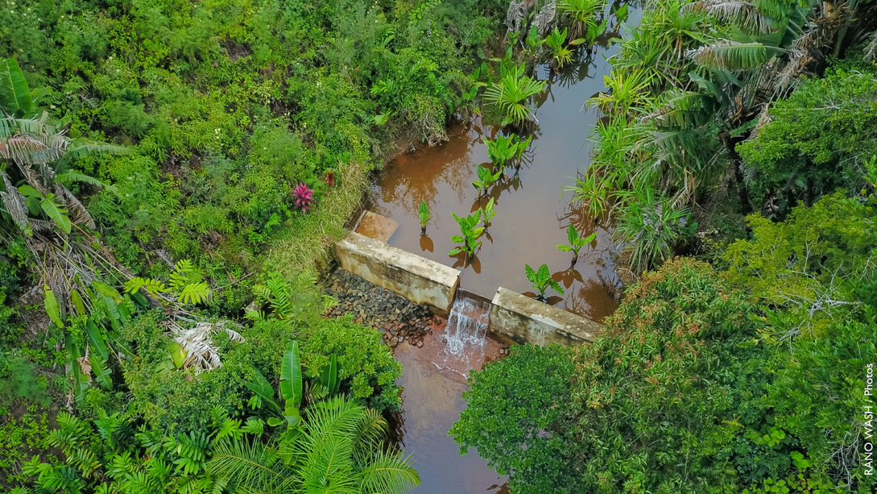

Closing WASH financing gaps: increasing local public investment in Madagascar
All systems go Africa
19-21 October 2022

Slide 2
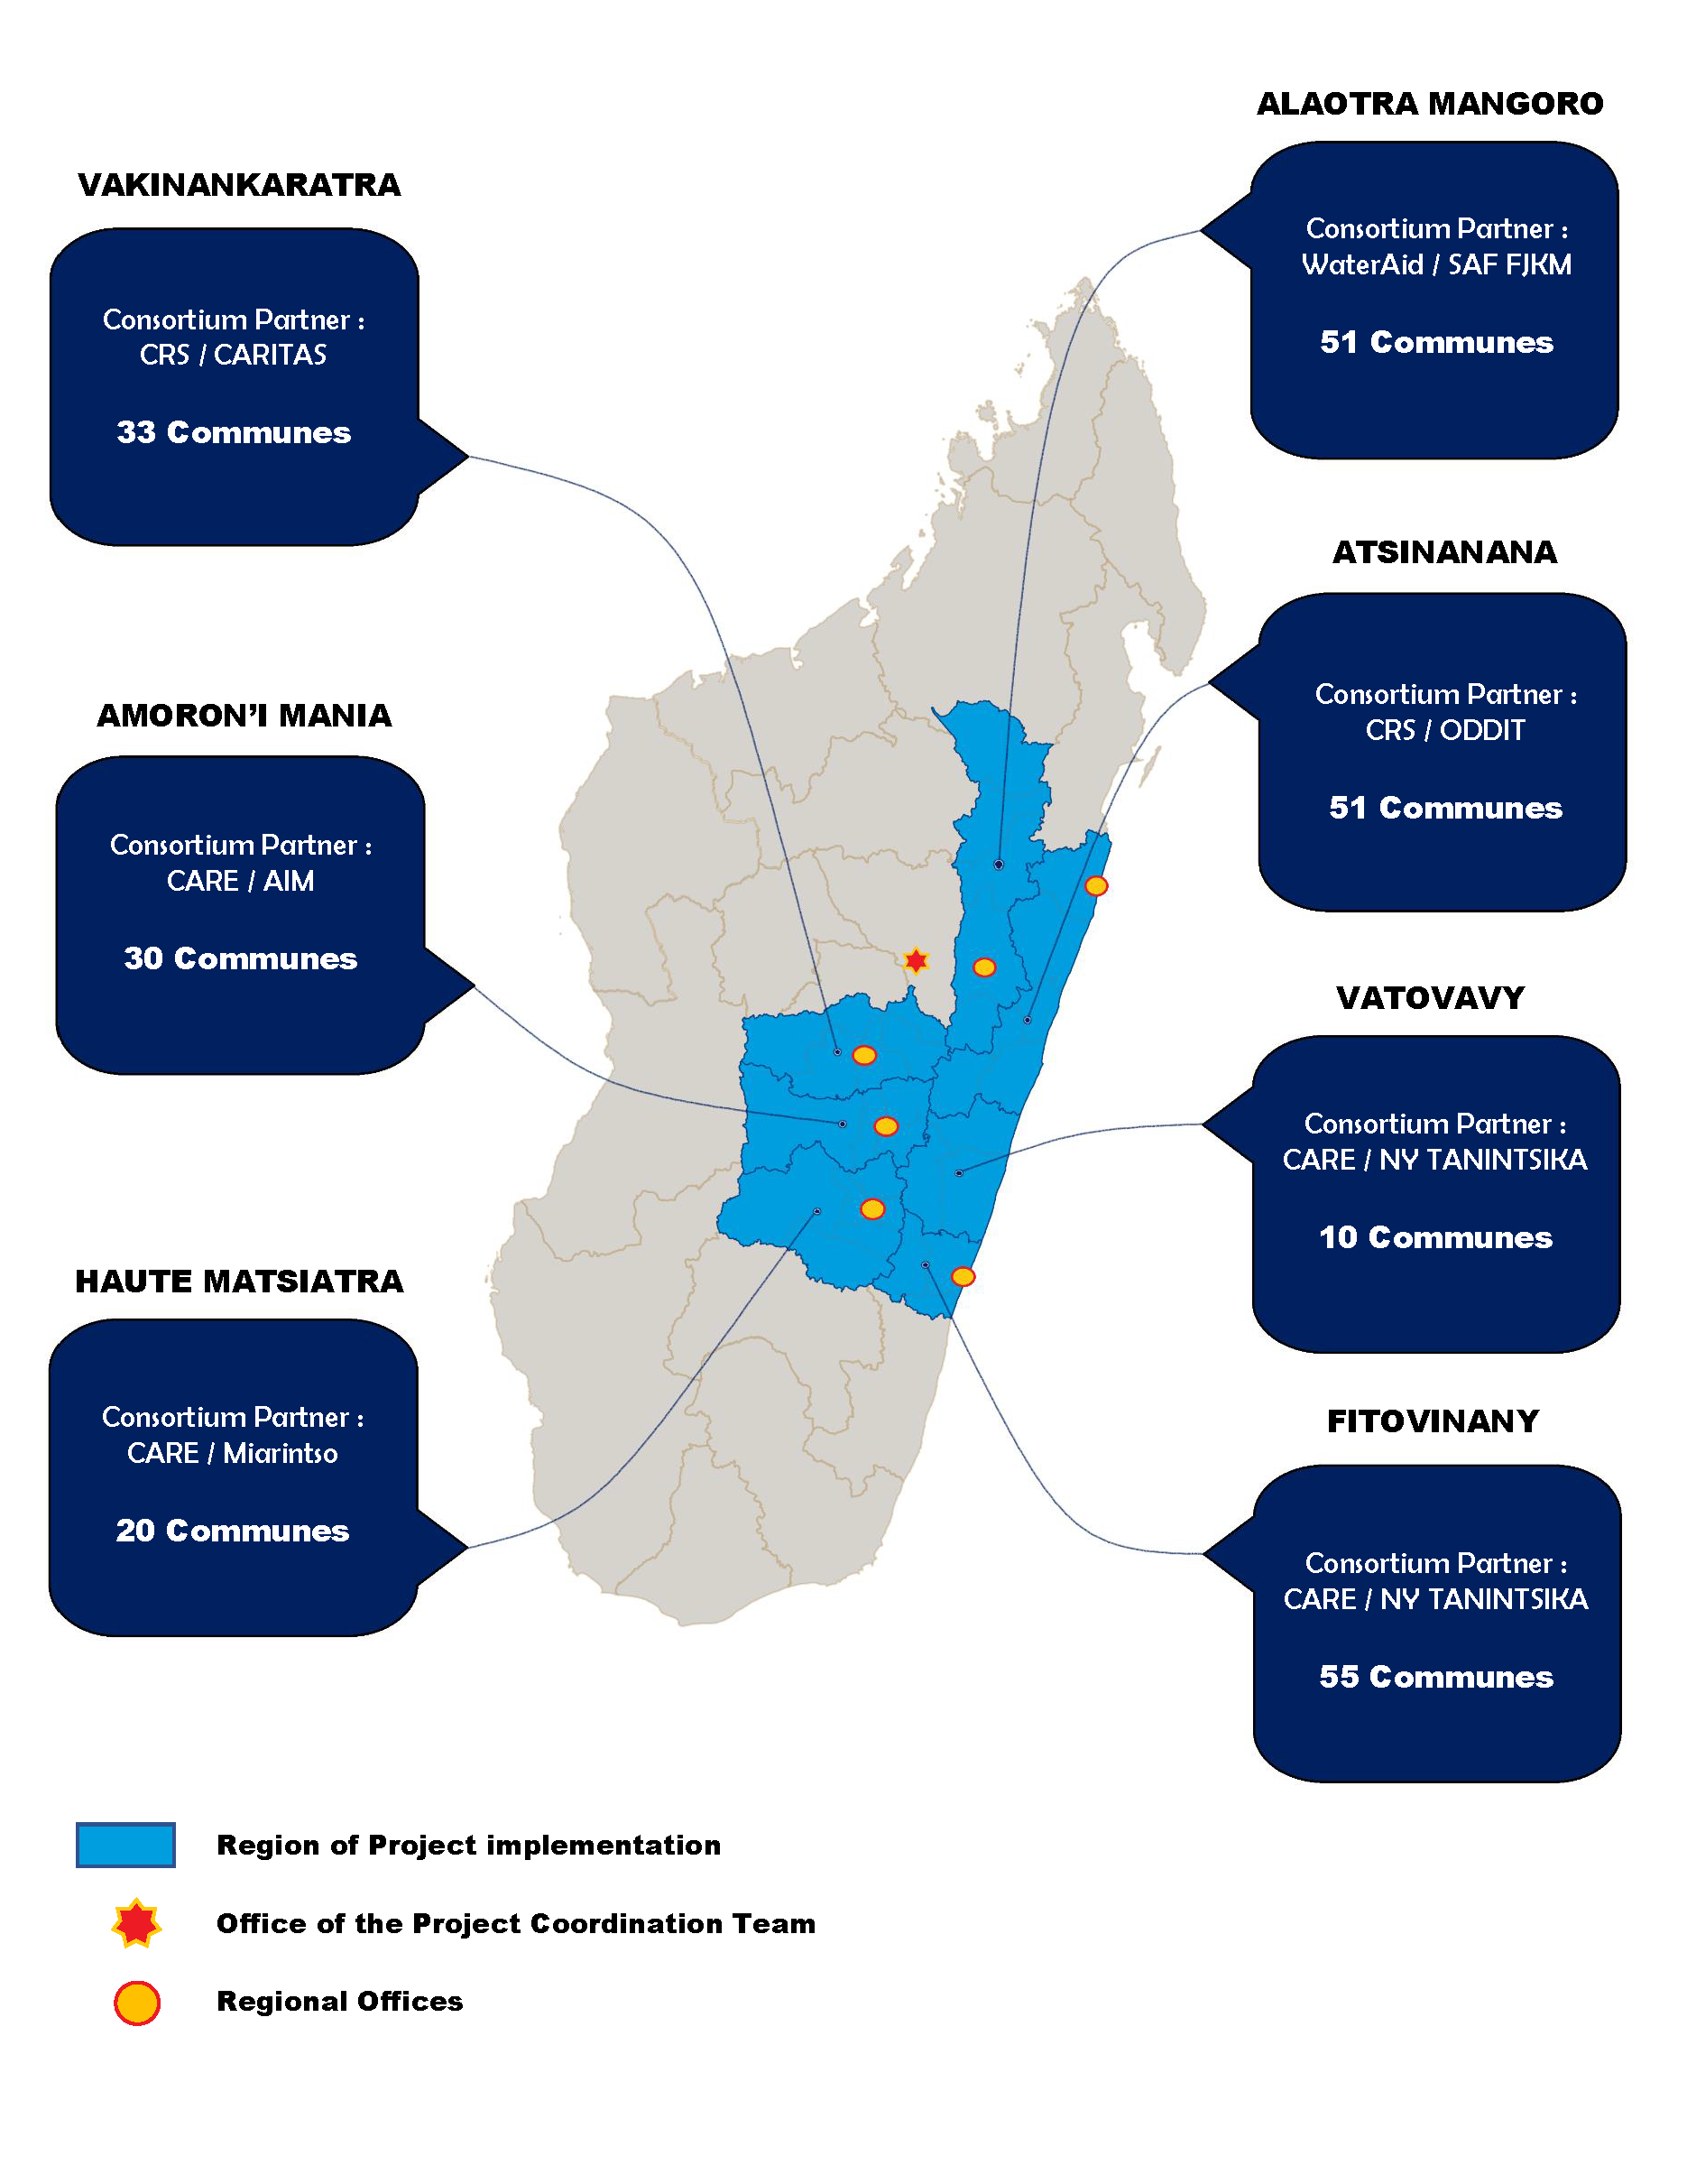
RANO WASH project overview
RANO WASH (RW): Rural Access to New Opportunities in Water, Sanitation, and Hygiene
A six-year project: June 2017 to June 2023 (includes one year extension)
Implemented by a consortium led by CARE International and composed of CARE, Catholic Relief Servies (CRS), WaterAid, and two Malagasy WASH Enterprises: Bush Proof and Sandandrano
Budget: 33 million USD (USAID)
Intervention areas: seven regions of Madagascar and 250 rural municipalities

Slide 3
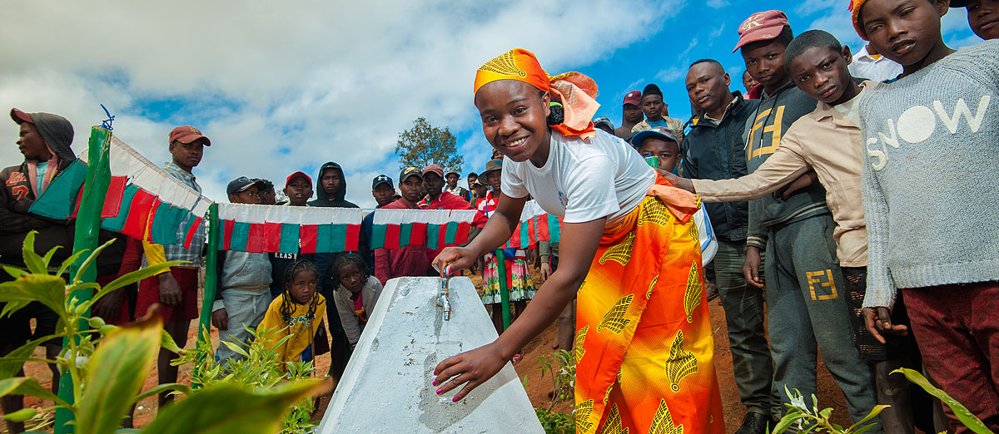
Contents
Our concept of Addressing the financing gap
The status of communes when we started
Our 6 observations?
Where we are after 3 years?

Slide 4
Addressing the financing gap
FUNDING AVAILABLE
LIFE CYCLE COSTING
IMPROVED FUNDING
Financing gap
Direct Support
Financing gap
CapManEx
Tariffs
Taxes
OPEX
Taxes
Tariffs
CAPEX
Transfers
Transfers

Slide 5
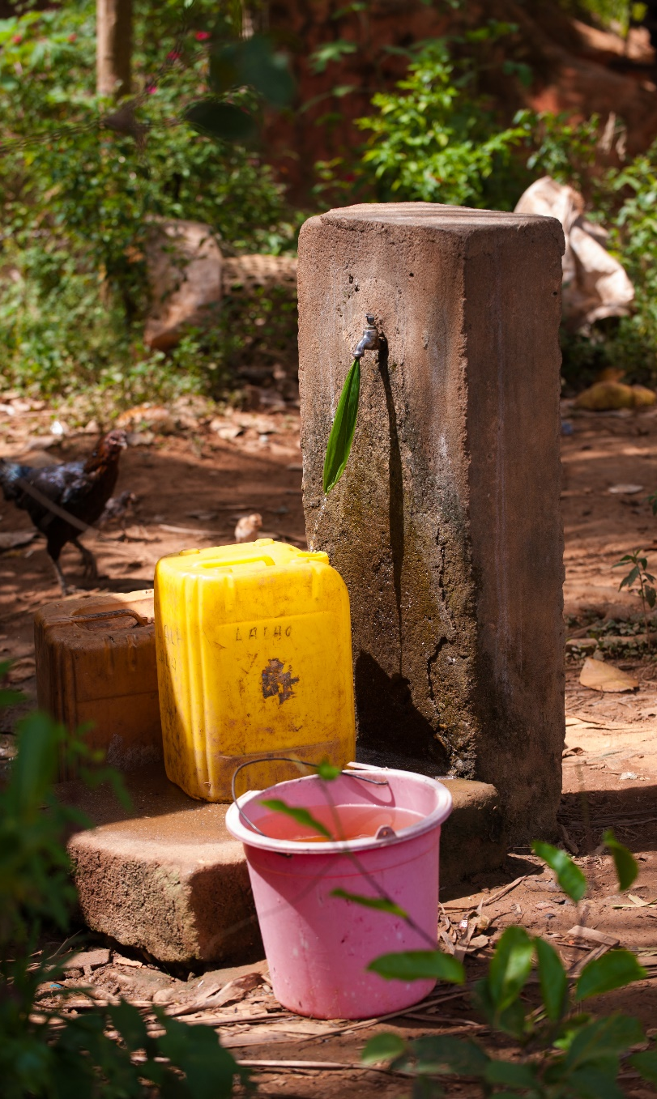
How it started…
Communes were dependent on external actors to develop their WASH services.
The commune owned the WASH services, but WASH improvements were mainly the result of external actor investment. No communal budget or other resources were allocated to WASH.
Budget support institutions did not consider WASH.
Support for communal budget development and implementation monitoring occured periodically, but there was no focus on WASH.
Other challenges:
WASH service providers/managers did not pay their fees to communes.

Slide 6
RANO WASH Theory of Change

Slide 7
Progressive improvements observed in the communes
Observation 1: Communes respond to community feedback
Observation 2:
Communes have WASH budgets and programs
Observation 3:
Communes improve the mobilisation of their tax revenue
Observation 5:
Communes engage with the private sector
Observation 6:
Communes improve their financial planning
Observation 4:
Communes implement WASH programs and improve transparency

Slide 8
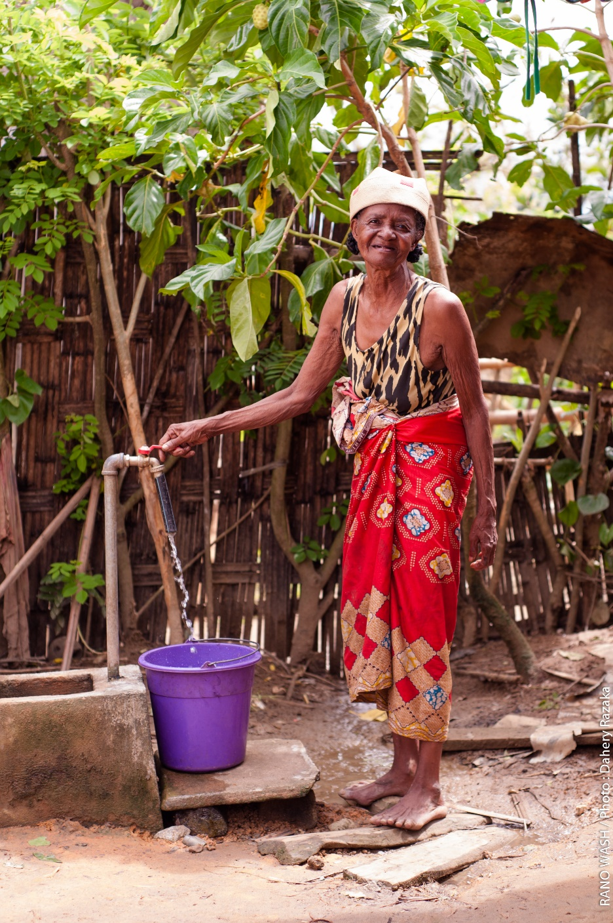
Observation 1: Communes respond to community feedback
Some communes have financed the rehabilitation of small water supply schemes or the construction of small sanitary blocks:
Ambahive Commune (Vatovavy) financed the repair of three handpumps by communal WASH technical serive (STEAH) following a consultation with the Local Consultation Structure (May 2022)
Fandrandava Commune (Haute Matsiatra) rehabilitated water supply schemes at the Communal Health Care Center (CSB) level.
Communes purchased sanitation materials for markets and public spaces
RW supported the commune in setting up spaces for dialogue (between Commune, community and service provider), and accountability mechanisms.
RW trained CSOs on advocacy and how to empower the community to demand their rights to water and sanitation.

Slide 9
Observation 2: Communes have WASH budgets and programs
From no budget, the WASH budget increased progressively each year.
The highest WASH budget is more than 66 million Ariary, while the majority is under 10 million Ariary per commune.

Slide 10
Observation 2: Communes have WASH budgets and programs
The ratio of WASH budget to the total commune budget
From no WASH budget, the priority of WASH within the commune budget is increasing.
The majority of communes have a WASH budget, which is just under 9% of the total communal budget.

Slide 11
Observation 2: Communes have WASH budgets and programs
Challenges experienced and solutions
Communes faced difficult writing (and reading) WASH component of a communal budget and especially on accounting codes for WASH activities
Slow pace of communes to prepare budget documents in accordance with the schedule foreseen by the texts
Weak transparency of budget documents
RANO WASH provided:
  Facilitated training on the budget process and accounting coding by the Regional Budget Unit (RBU);
  Budget monitoring by CSOs.

Slide 12
Observation 3: Communes improve the mobilisation of their tax revenue
From no tax revenue collected, Andrainjato commune (Haute Matsiatra region) has collected 15 million Ariary.
In other regions – Vatovavy Fitovinany Region -, with a second year support, the tax revenue collected reached 70 million Ariary for one commune. (Not in the graph)

Slide 13
Observation 3: Communes improve the mobilisation of their tax revenue
Challenges experienced and solutions
Example of taxes collected by 1 commune in the first year:
Wood
Local products
Tourist taxes
Slaughter
Docking fees
Water service operators' 8% fees
Certification
Authorization of landfill
Customary ceremonies
Synthetic tax and license
Beach and market fees
Fines
Impoundment fee
Bovine identification form
Lack of political will of the Mayor to mobilize tax revenues.
Lack of capacity of the commune tax agents to mobilize tax revenue.
Lack of ideas to motivate community to pay taxes
  The Regional Budget Unit trained commune tax agents and coached communes on tax revenue mobilization.
  RANO WASH facilitated exchange of good practices between communes on tax revenue mobilization.

Slide 14
Observation 4: Communes implement WASH programs and improve transparency
Step 1:
Train communes
on STEFI process
Step 2:
Fill and send technical and financial survey form
Step 3:
Audit by DREAH (Technical, organizational, financial)
Step 5: Validation of findings and elaboration of recovery plan
Step 7: Implementation and monitoring of the plan
Step 4: Compilation and analysis from survey form and audit results
Step 6: Validation of findings at communal level
Regional Directorate of the MoWASH (DREAH) increased their technical and financial monitoring of water service providers/managers (STEFI) to strengthen transparency and the collection of municipal fees
Improved tax collection from private water providers/managers
Obtained technical and financial information about the water supply schemes,
to help commune to oversee service quality and service provider to improve.
These performances are shared at regional level and at communal level.

Slide 15
Observation 5: Communes engage with the private sector
RW supported communes to have dialogue with private sector actors to:
  Develop technical documents (project document, business plan, …)
  Prepare the municipality to "sell" the potential services, model potential financial yields, and optimize performance
  Organise business to business (B2B) fairs.
  Support the two parties to establish agreement on the construction, extension, and management of the drinking water services
Provision of materials for the project and co-financing of the work by the commune, the private sector, and other development actors (Commune Mandialaza case)
Co-funding with high participation of the municipality
(Commune Sendrasoa Case)
Co-funding with high participation of the private sector
(Commune Ihazoara Case)
Support of private sector to access the commune market

Slide 16
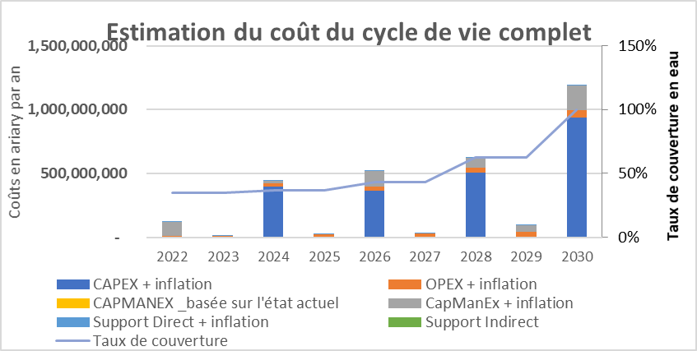
Observation 6: Communes improve their financial planning
Life Cycle Cost Estimation
Cost in Ariary
Water coverage rate
Excel tools used to calculate life cycle costs
Models developed - cost references managed/updated by the Ministry teams
Tools managed by Commune with annual update to help them during budgeting process

Slide 17
What has been the overall impact?
  98% of the 144 communes surveyed and supported by RANO WASH now have a WASH budget.
  Support from Regional Budget Unit was a key success factor. DREAH will need to increase its support to communes to scale up and sustain progress.
  255 communal-CSOs, 246 local dialogue structures (SLC), and 200 accountability mechanisms surveyed and found functional during the last three months.
  These are local autonomous mechanisms. Commune support, regional-CSO monitoring, and district coaching can help to sustain them.
  Tax revenue mobilization has increased allowing communes to finance their WASH budget and other priorities.
  The regional budget directorate (DRB) will continue to support expanding the tax base progressively.
  Five regional WASH directorates are undertaking the Technical and Financial Follow-up (STEFI) of the quality of services provided by the drinking water management and the commune.
  Their interventions concern all private water service providers in the region and are not only related to the municipalities supported by RANO WASH.
  222 communes supported by RANO WASH have WASH plans
  The regional directorate of WASH (DREAH) has provided technical support to the commune to establish these WASH plans.

Slide 18
How can we improve the process?
Institutionalize WASH budget monitoring by the Ministry of Decentralization and the Ministry of WASH.
Scale up the inclusion of WASH in commune budgets and the training and coaching of communes provided by the Regional Budget Directorate in the Ministry of Finance.

Slide 19
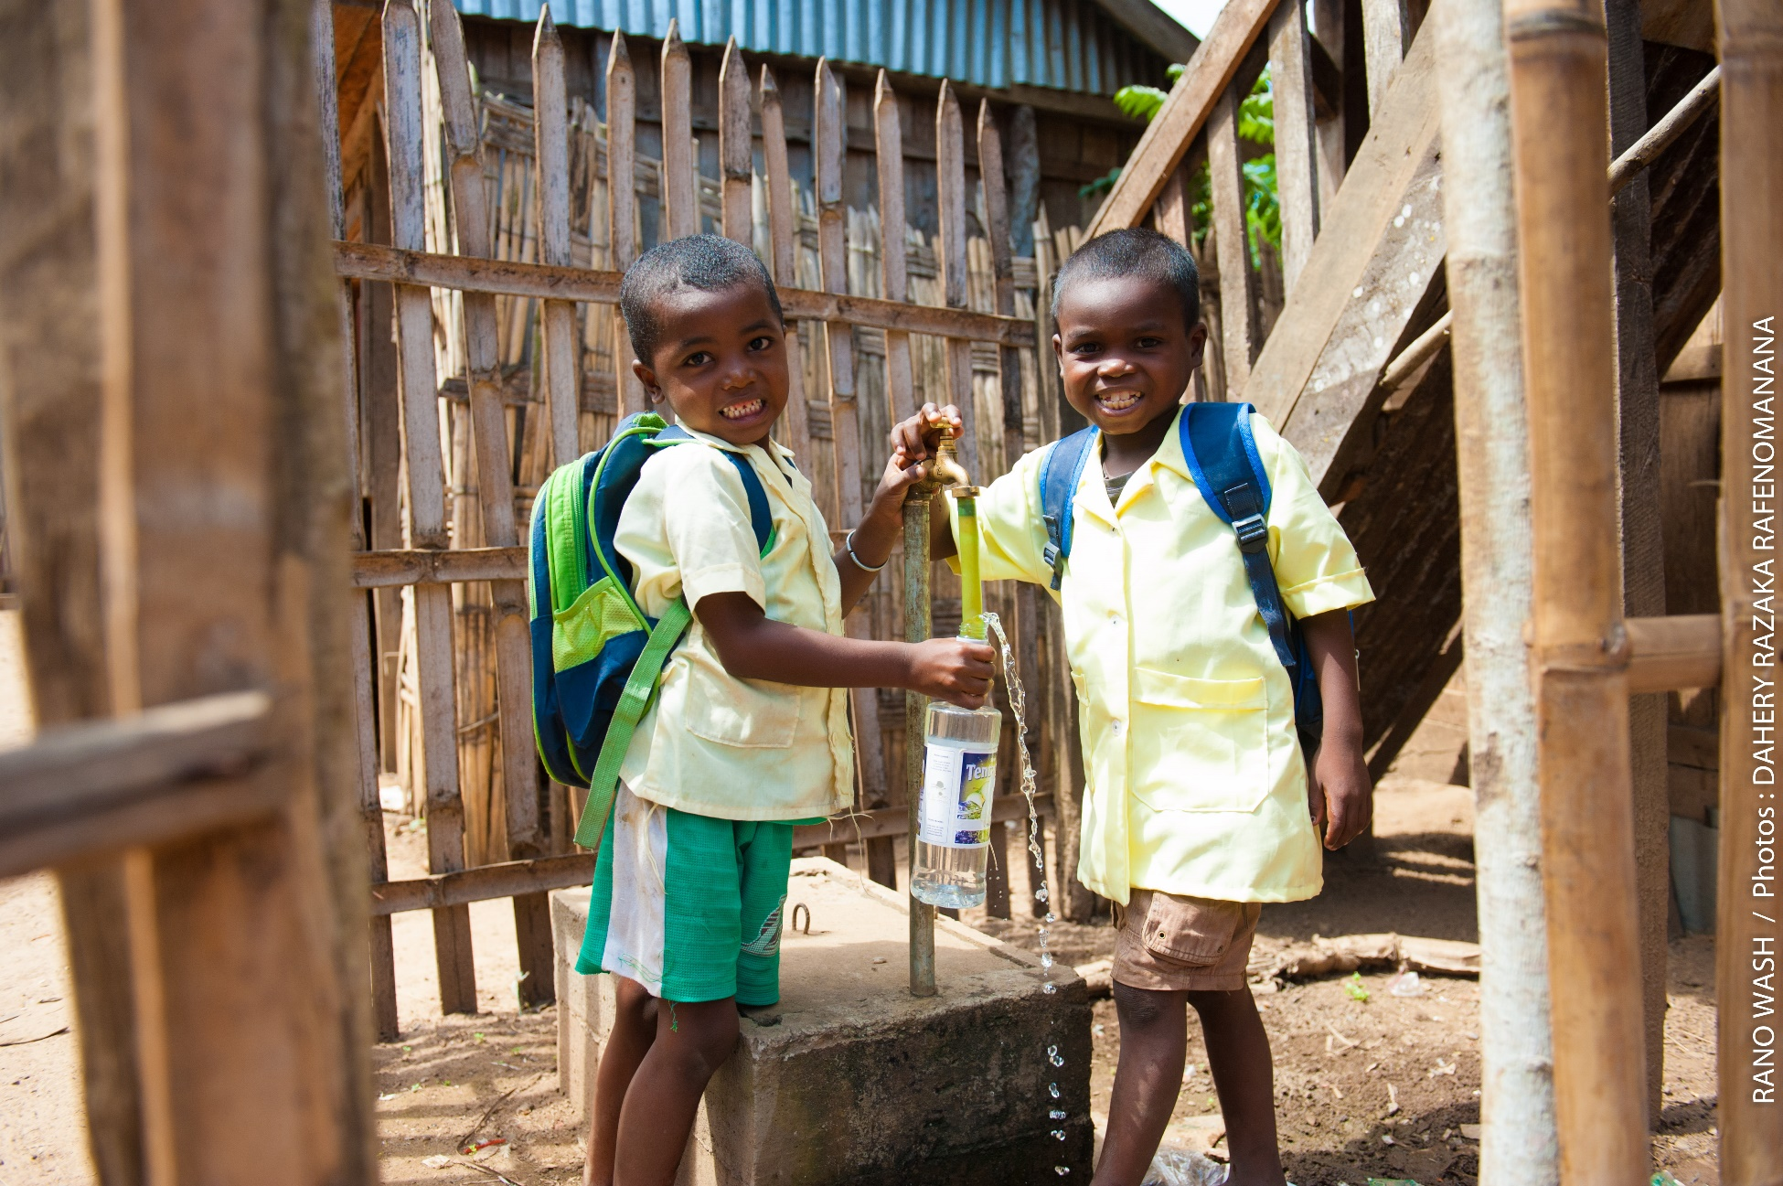
Misaotra betsaka!
(Thank you!)

